Slide 1
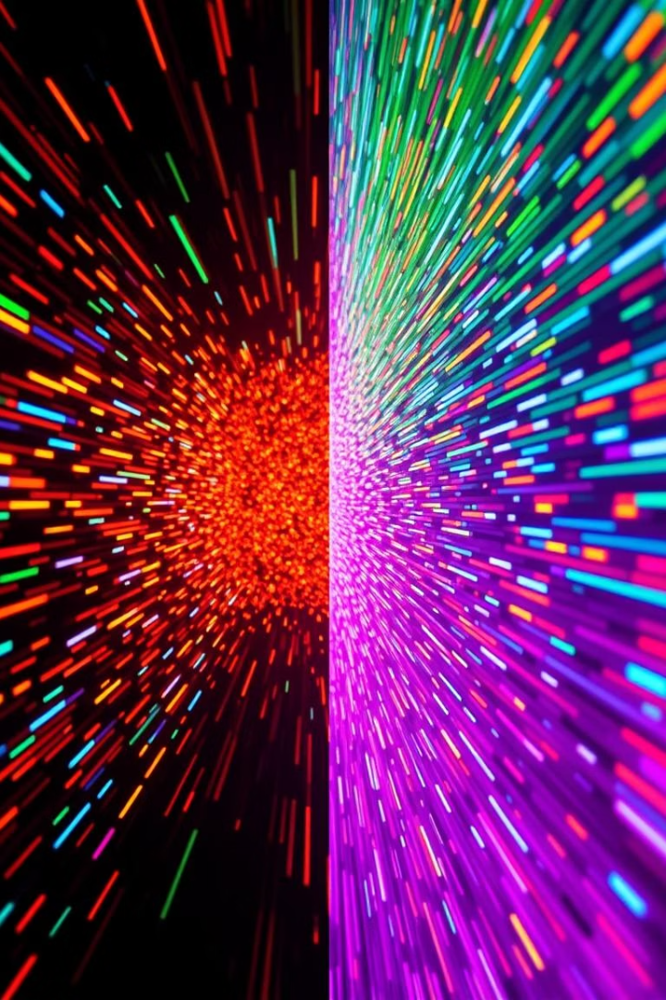
Optical Flow
Understanding Motion in Videos and Image Sequences
by Mouneeswaran

Slide 2
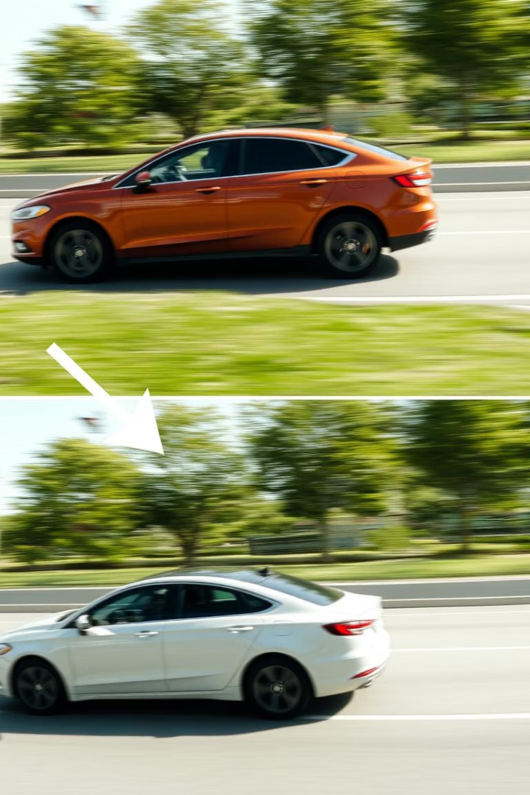
What is Optical Flow?
Method to estimate apparent motion of scene points from a sequence of images
TOPICS:
1)Motion field and Optical flow
2) Optical flow constancy constraint
3)Lucas Kanade algorithm
4)Coarse to fine flow estimation

Slide 3
Where is Optical Flow Used?
Object tracking
Medical imaging
Robot navigation
Traffic monitoring
Video compression

Slide 4
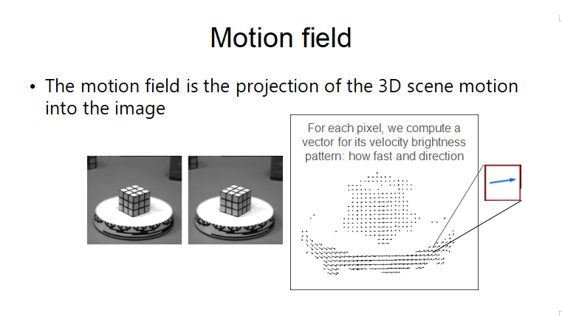

Slide 5
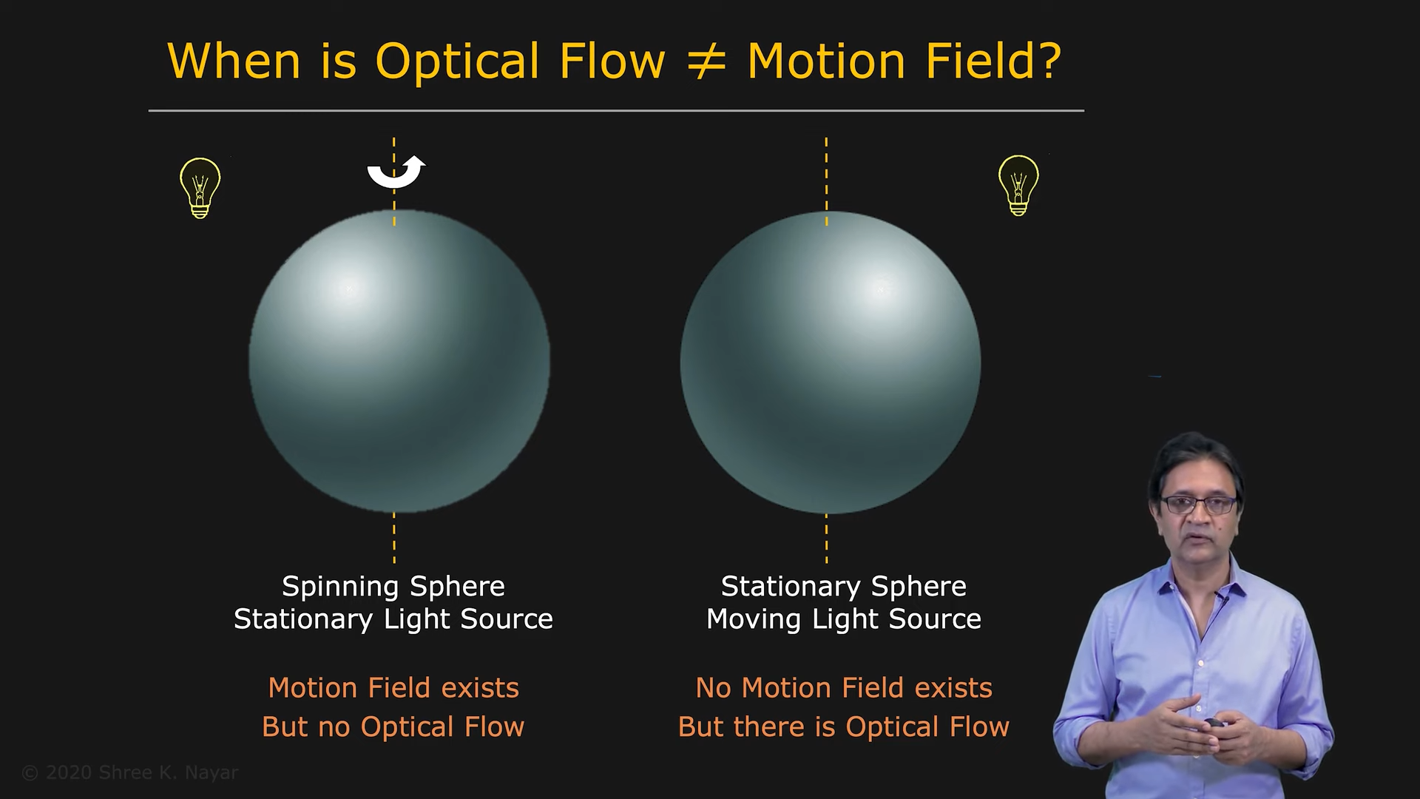


Slide 6
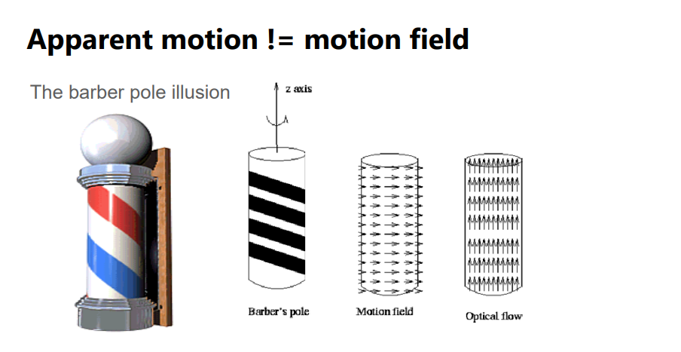
http://en.wikipedia.org/wiki/Barberpole_illusion

Slide 7
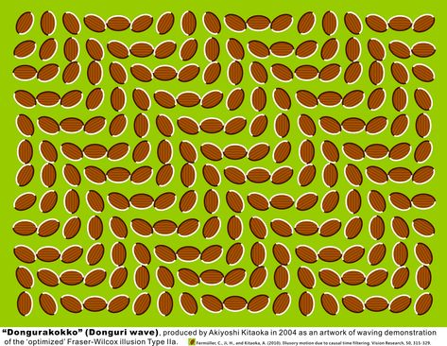
Motion illusions
-Donguri wave illusion

Slide 8
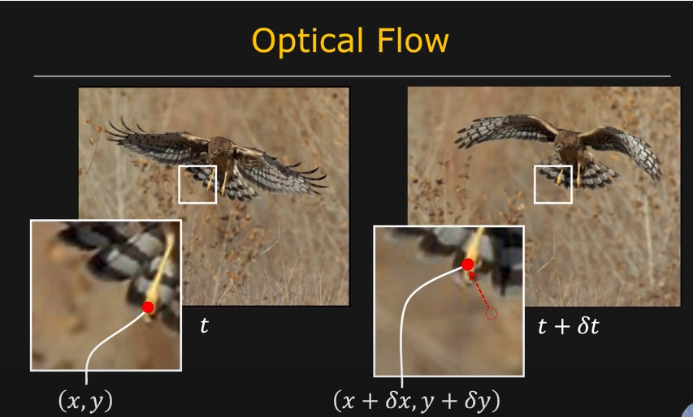
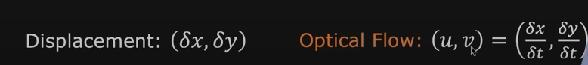

Slide 9
How Does Optical Flow Work?
Assumptions
Process
Brightness Constancy: Pixel intensity constant
Compare pixel changes to compute motion vectors
Small Motion: Minor movement between frames

Slide 10
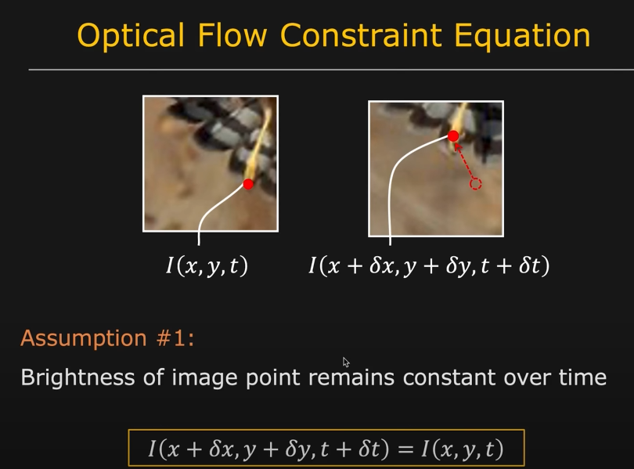

Slide 11
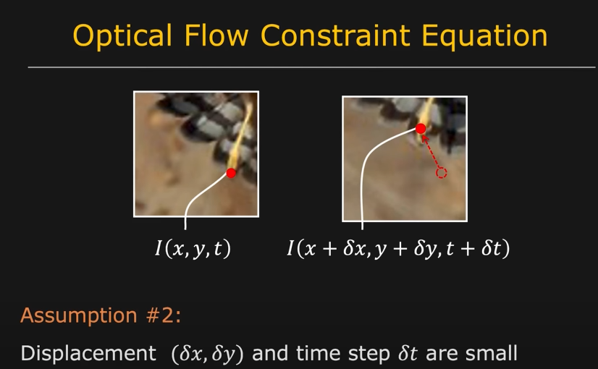

Slide 12
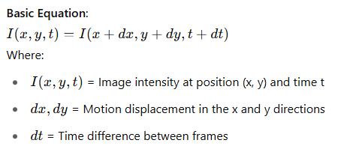
Equation

Slide 13
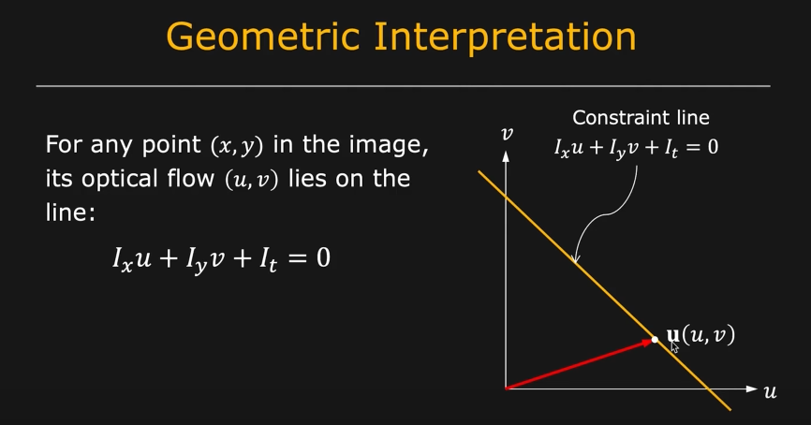

Slide 14
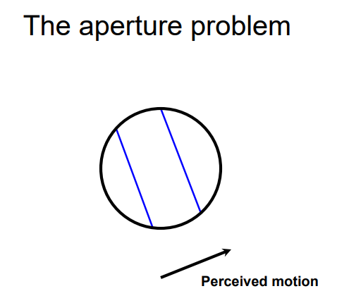
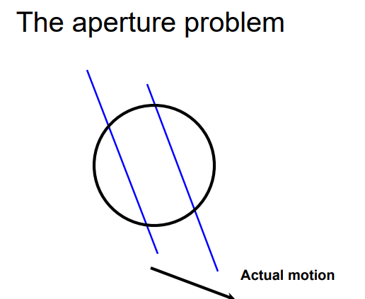
Aperture problem

Slide 15
Optical Flow Methods
Sparse Optical Flow
Dense Optical Flow
Tracks select points (corners)
Tracks every pixel
Example: Lucas-Kanade method
Example: Farneback method

Slide 16
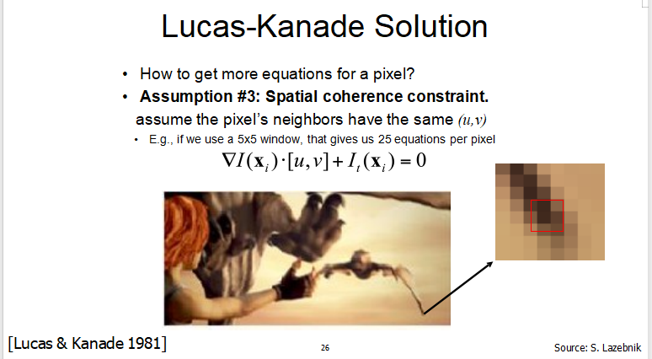

Slide 17
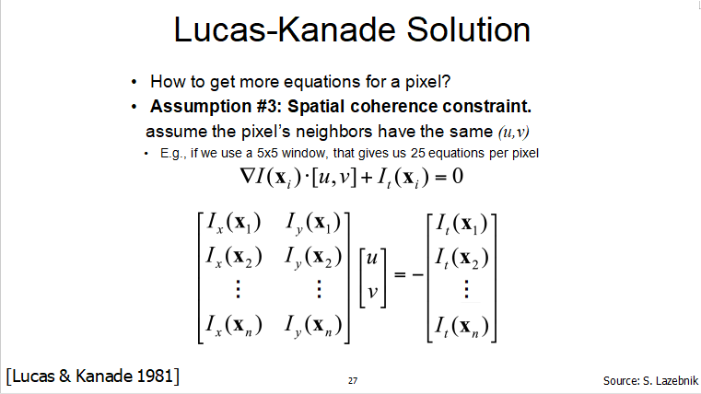

Slide 18
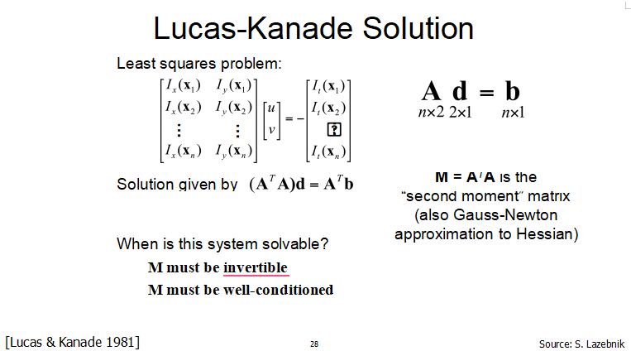

Slide 19
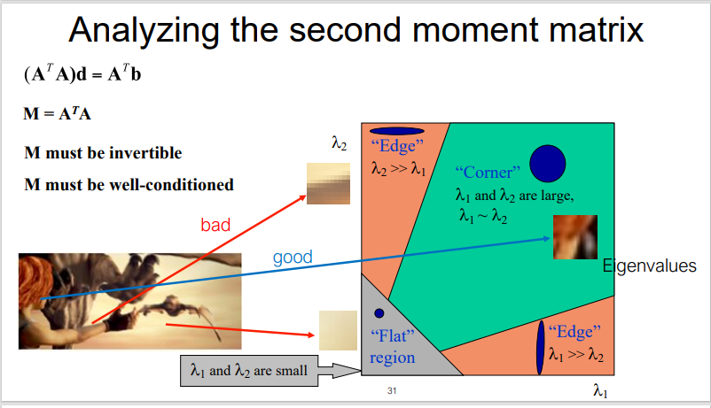

Slide 20
What if we have large motion?
Solution :
1) Coarse to Fine flow estimation
2) Template matching

Slide 21
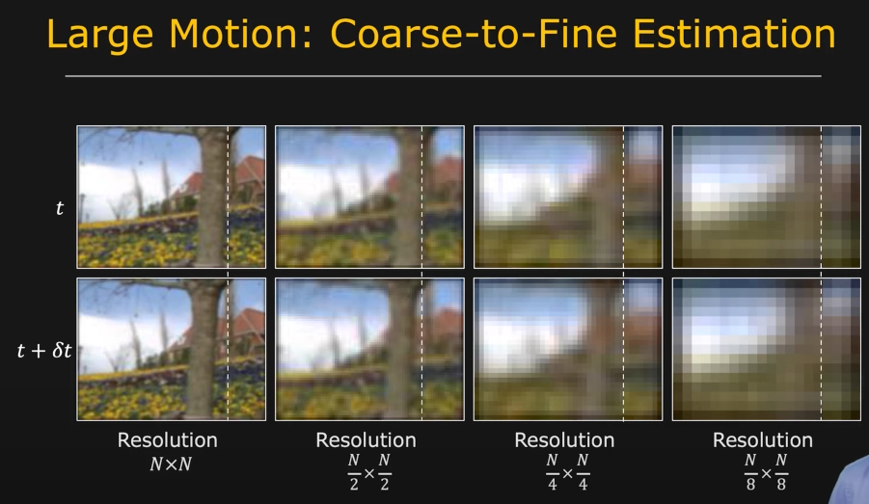

Slide 22
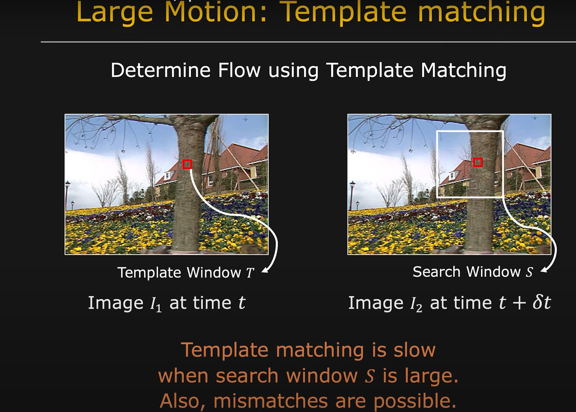

Slide 23
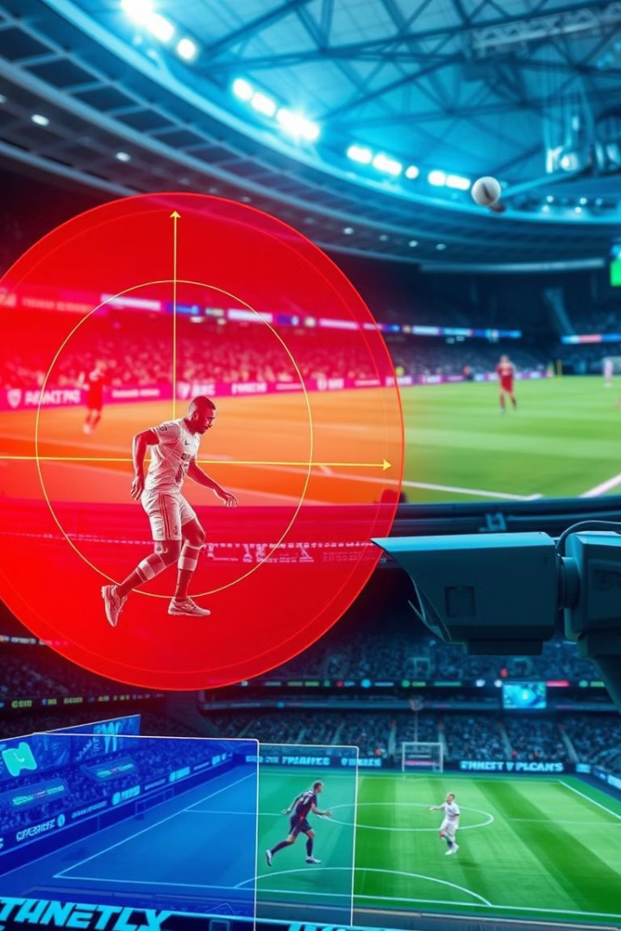
Applications in Real World
Sports Analysis
Augmented Reality
Track player movement
Align virtual with real motion
Surveillance
Detect suspicious movement

Slide 24

Summary
Optical Flow = pixel motion between frames
Used in AR, robotics, video analysis
Two types: Sparse and Dense
Enables machines to see and react to motion

